Slide 1
Chrochrome change detection on “Viareggio 2013 Trial” dataset
Eldar Mamedov
Yaniv Lerner

Slide 2
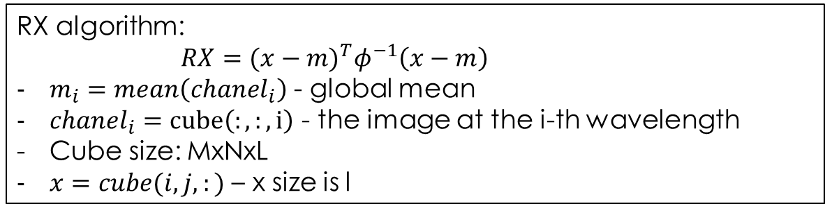
Background
Inv. Covarince Matrix
Global mean vector
Local pixel
RX algorithm:
$RX={(x−m)}^{T}φ^{−1}\left(x−m\right)$
$m_{i}=mean\left(chanel_{i}\right)$ - global mean
$chanel_{i}=cube\left(:,:,i\right)$ - the image at the i-th wavelength
Cube size: MxNxL
$x=cube(i,j,:)$ – x size is l

Slide 3
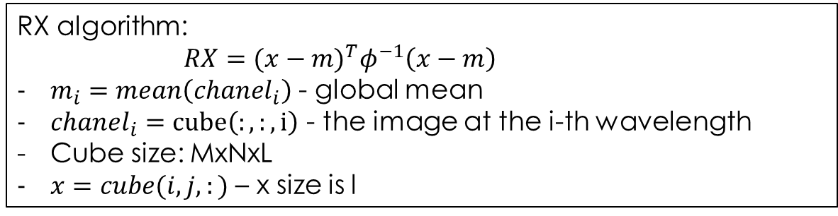
Goal
RX algorithm:
$RX={(x−m)}^{T}φ^{−1}\left(x−m\right)$
$m_{i}=mean\left(chanel_{i}\right)$ - global mean
$chanel_{i}=cube\left(:,:,i\right)$ - the image at the i-th wavelength
Cube size: MxNxL
$x=cube(i,j,:)$ – x size is l

Slide 4
Data-Set

Slide 5
Workspace

Slide 6
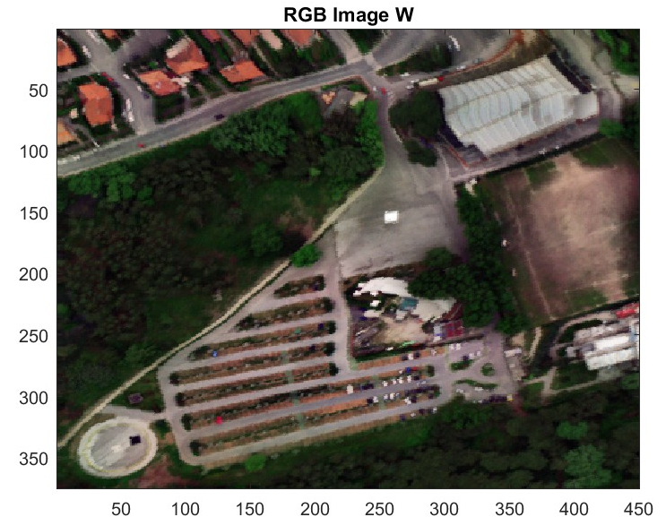
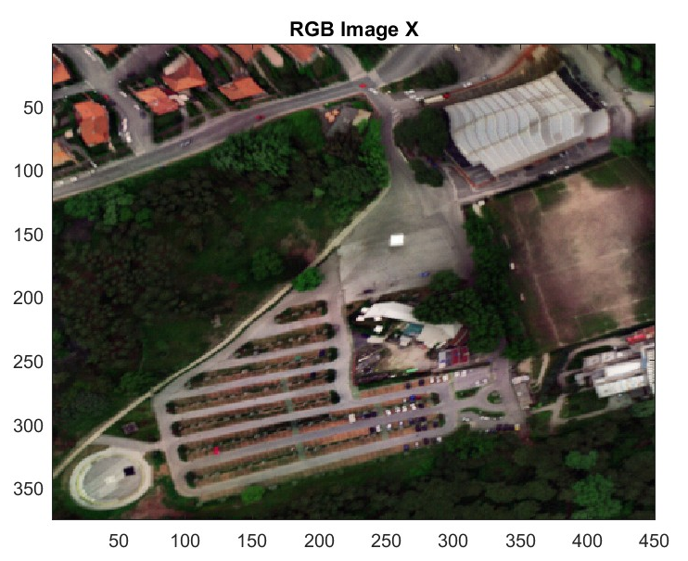
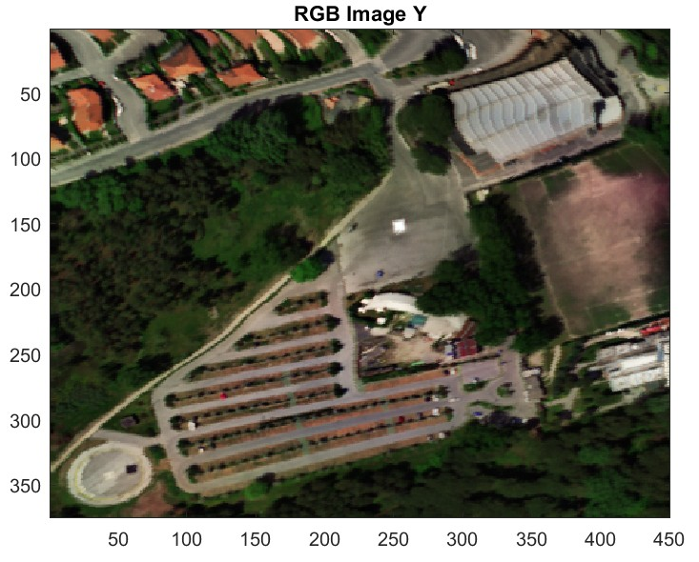
RGB images show
Our goal is to find the anomalies in day 1(X) to day 2 (Y) with image subtraction and Chrochrome algo [].
Then comparison between day 1
To day 1 after 1 hour (W)

Slide 7
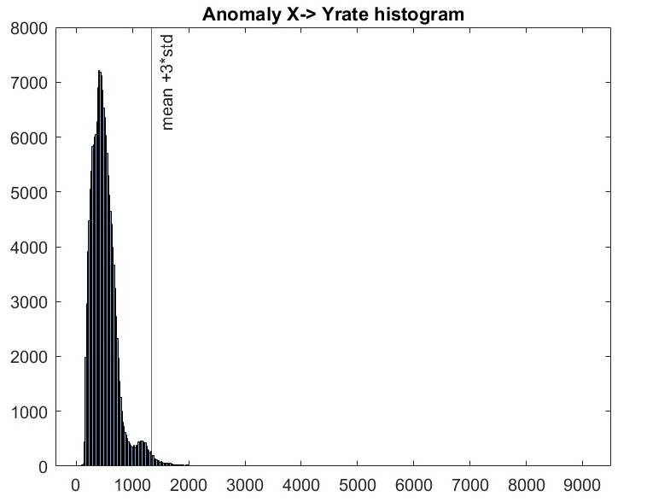
Histogram with mean +3*std threshold

Slide 8
Anomaly rate as an image

Slide 9
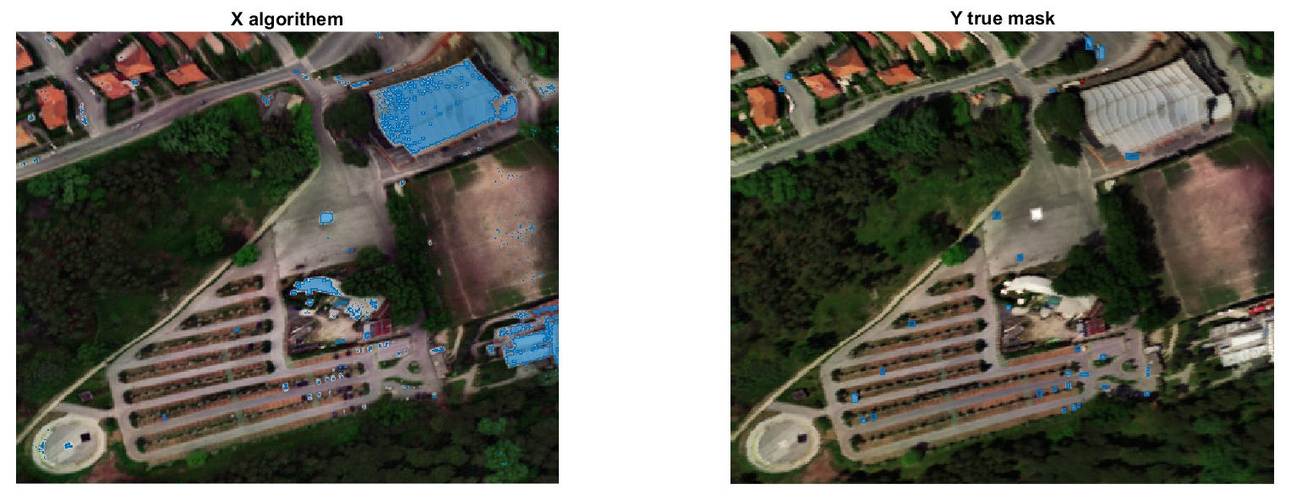
Change detection results

Slide 10
Reference

